Slide 3
FORMS OF BUSINESS ORGANISATIONS
SOLE PROPRIETORSHIP
One owner
Very simple
Unlimited liability
The firm has no separate status from a legal and tax point of view
PARTNERSHIP
Two or more owners
Fairly simple
Unlimited liability
The firm has a separate status
PRIVATE LIMITED COMPANY
Upto 50 owners
Not too complex
Limited liability
A distinct legal person

Slide 4
FORMS OF ORGANISATIONS
PUBLIC LIMITED COMPANY
Many owners
Somewhat complex
Limited liability
Distinct legal person
Free transferability of shares
PUBLIC LIMITED COMPANY’S ATTRACTION
The potential for growth is immense because of access to substantial funds
Investors enjoy liquidity because of free transferability of securities
The scope for employing talented managers is greater

Slide 5
FINANCIAL DECISIONS IN A FIRM
Capital Budgeting
Capital Structure
Working Capital Management

Slide 6
GOAL OF FINANCIAL MANAGEMENT
Finance theory rests on the premise that managers should manage their firm’s resources with the objective of enhancing the firm’s market value.
“The quest for value drives scarce resources to their most productive uses and their most efficient users. The more effectively resources are deployed, the more robust will be the economic growth and the rate of improvement in our standard of living. Adam Smith’s ‘invisible hand’ is at work when investors’ private gain is a public value.”

Slide 7
SHAREHOLDER ORIENTATION IN INDIA
In the wake of liberalisation, globalisation, and institutionalisation of the capital market, there is a greater incentive to focus on creating value for shareholders. The following observations are clear indications.
DHIRUBAI AMBANI : In everything that we do, we have only one supreme goal, that is to maximise your wealth as India's largest investor family.
ANAND MAHINDRA : All of us are beginning to look at companies as owned by shareholders. The key is to raise shareholder returns.

Slide 8
ALTERNATIVE GOALS
MAXIMISATION OF PROFIT
This goal is not as inclusive a goal as maximisation of shareholders’ wealth. Its limitations are:
• Profit in absolute terms is not a proper guide to decision making. It should be expressed either on a per share basis or in relation to investment.
• It leaves considerations of timing and duration undefined.
• It glosses over the factor of risk
MAXIMISATION OF EPS OR ROE
While these goals do not suffer from the first limitation mentioned above, they suffer from the other two limitations.

Slide 9
THE FUNDAMENTAL PRINCIPLE OF FINANCE
A business proposal-regardless of whether it is a new investment or acquisition of another company or a restructuring initiative –raises the value of the firm only if the present value of the future stream of net cash benefits expected from the proposal is greater than the initial cash outlay required to implement the proposal.
CASH ALONE MATTERS
Investors
Shareholders
Lenders
Investors provide the initial cash required
to finance the business proposal
The business proposal
The proposal generates
cash returns to investors

Slide 10
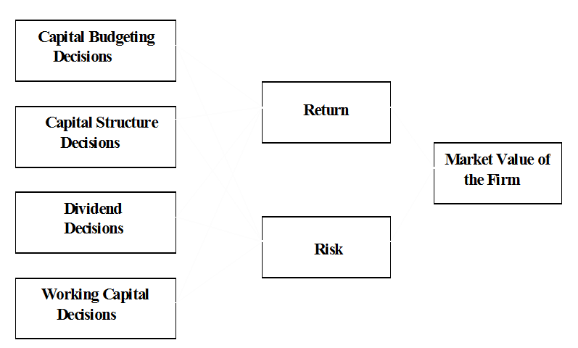
DECISIONS, RETURN, RISK, AND MARKET VALUE

Slide 11
AGENCY PROBLEM
While there are compelling reasons for separation of ownership and management, a separated structure leads to a possible conflict of interest between managers and shareholders.
The lack of perfect alignment between the interests of managers and shareholders results in the agency problem.
To mitigate the agency problem, effective monitoring has to be done and appropriate incentives have to be offered.

Slide 12
ALL MANAGERS ARE FINANCIAL MANAGERS
The engineer, who proposes a new plant, shapes the investment policy of the firm
The marketing analyst provides inputs in the process of forecasting and planning
The purchase manager influences the level of investment in inventories
The sales manager has a say in the determination of the receivables policy
Departmental managers, in general, are important links in the finance control system of the firm

Slide 13
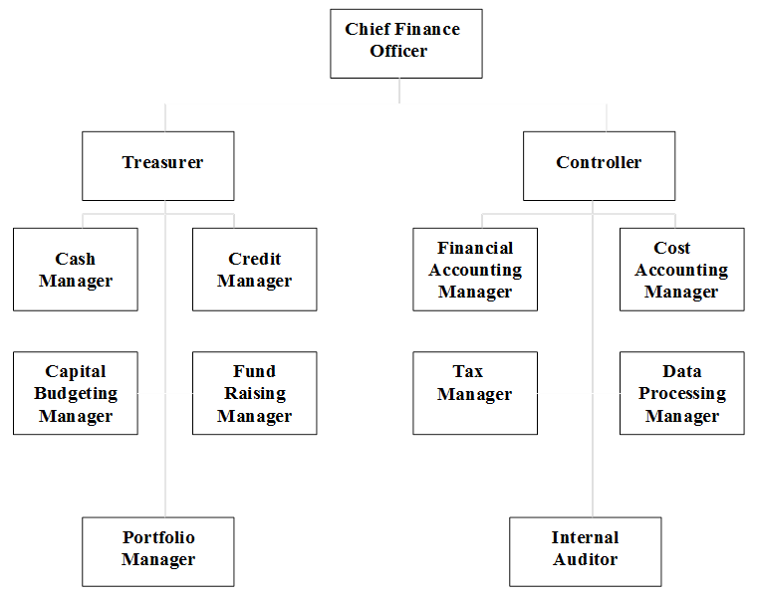
ORGANISATION OF FINANCE FUNCTION

Slide 14
RELATIONSHIP OF FINANCE TO ECONOMICS
Macroeconomic environment defines the setting within which the firm operates. GDP growth rate, savings rate, fiscal deficit, interest rates, inflation rate, exchange rates, tax rates, and so on have an impact on the firm
Microeconomic theory provides the conceptual underpinnings for the tools of financial decision making. Finance, in essence, is applied microeconomics.

Slide 15
RELATIONSHIP OF FINANCE TO ACCOUNTING
Accounting is concerned with score keeping, whereas finance is aimed at value maximising.
The accountant prepares the accounting reports based on the accrual method. The focus of the financial manager is on cash flows.
Accounting deals primarily with the past. Finance is concerned mainly with the future.

Slide 16
SUMMING UP
There are three broad areas of financial decision making, viz., capital budgeting, capital structure, and working capital management.
Finance theory, in general, rests on the premise that the goal of financial management should be to maximise the wealth of shareholders.
A business proposal raises the value of the firm only if the present value of the future stream of net cash benefits expected from the proposal is greater than the initial cash outlay required to implement the proposal.
A confluence of forces appears now to be prodding Indian companies to accord greater importance to the goal of shareholder wealth maximisation.
In general, when you take a financial decision, you have to answer the following questions : What is the expected return ? What is the risk exposure ? Given the risk-return characteristics of the decision, how would it influence value ?

Slide 17
SUMMING UP
Contd…
The important forms of business organisation are : sole proprietorship, partnership, private limited company, and public limited company.
While each form of organisation has certain advantages and limitations, the public limited company form of organisation generally appears to be the most appropriate form from the point of view of shareholder wealth maximisation.
While there are compelling reasons for separation of ownership and management, a separated structure leads to a possible conflict of interest between managers and shareholders.
The lack of perfect alignment between the interests of managers and shareholders results in the agency problem. To mitigate the agency problem, effective monitoring has to be done and appropriate incentives have to be offered.

